Slide 1
Milind Parab

Slide 2
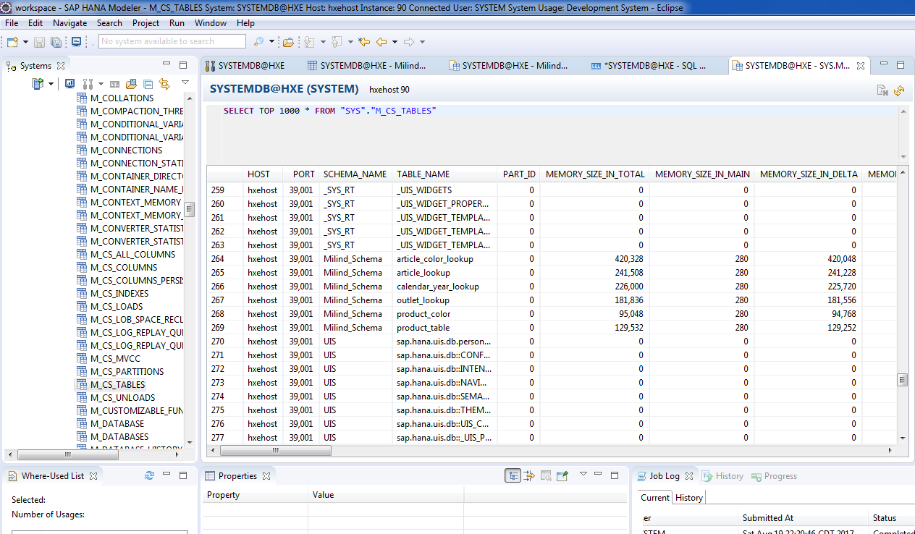
If you want to check the table size and content. Schema “SYS”→ Views→M_CS_Table.

